Slide 1
CSC 480: Artificial Intelligence -- Search Algorithms --
Franz J. Kurfess
Professor
Computer Science Department
California Polytechnic State University
San Luis Obispo, CA, U.S.A.

Slide 2
Use and Distribution of these Slides
These slides are primarily intended for the students in classes I teach. In some cases, I only make PDF versions publicly available. If you would like to get a copy of the originals (Apple KeyNote or Microsoft PowerPoint), please contact me via email at fkurfess@calpoly.edu. I hereby grant permission to use them in educational settings. If you do so, it would be nice to send me an email about it. If you’re considering using them in a commercial environment, please contact me first.

Slide 3
Course Overview
Introduction
Intelligent Agents
Search
problem solving through search
uninformed search
informed search
Games
games as search problems
Knowledge and Reasoning
reasoning agents
propositional logic
predicate logic
knowledge-based systems
Learning
learning from observation
neural networks
Conclusions

Slide 4
Logistics
Senior Project working with Emotiv (Adam Rizkalla) on using BCI devices for adaptive music playlists
AI Nugget presentations
proposals and past presentations mostly graded
Section 1:
Stephen Calabrese: Wolfram Alpha
Brandon Page: Google Now
Adin Miller: AI System Builds Video Games
Section 3:
Luke Larson: Crusher
Jorge Mendoza: Behind IBM’s Watson
Bot/WumpusEnvironment
source code, JavaDocs for WumpusEnvironment is on PolyLearn
post insights of potential interest for others on the PolyLearn forum

Slide 5
Chapter Overview Search
Motivation
Objectives
Search as Problem-Solving
problem formulation
problem types
Uninformed Search
breadth-first
depth-first
uniform-cost search
depth-limited search
iterative deepening
bi-directional search
Informed Search
best-first search
search with heuristics
memory-bounded search
iterative improvement search
Non-Traditional Search
local search and optimization
constraint satisfaction
search in continuous spaces
partially observable worlds
Important Concepts and Terms
Chapter Summary

Slide 6
Logistics
see also Moodle Discussion Board Announcement
Labs
L2 demos in lab continued
L3 demos in lab starting Tue, April 28
L4: Search Algorithms
continuation of L3: uniform cost, best-first (greedy), A*
available now
deadline moved to Tue, May 19
Quizzes
Q3 deadline tonight
Q4 open now, deadline next Tue (April 28)
Project
evaluation in progress of the following documentation parts
Overview
Features, Requirements, Evaluation Criteria

Slide 7
Logistics 2
Upcoming AI & HCI Classes
W14: CPE 484 (2 sections)
S14: CPE 481, 580
AI Nugget presentations
Section 1
Summers, Garrett: Game Artificial Intelligence In Bioshock Infinite
Alvin Bokun Feng: Genetic Algorithms
Section 3
Jordyn Battle: Skullgirls' approach to fighting game AI
Mark Feldman: Object Recognition and HOG

Slide 8
Revisions:
2009-10-14
split this chapter into two parts, to prepare for the transition to the 3rd edition
added some pictures and diagrams
This set of slides is the second one of the part on search algorithms.

Slide 9
Logistics
Introductions
Course Materials
textbook
handouts
Web page
CourseInfo/Blackboard System
Term Project
Lab and Homework Assignments
Exams
Grading

Slide 10
Motivation
“conventional” search strategies and the respective algorithms are becoming more and more part of the “standard” computer science area
some alternative search methods have been developed that deal with problems and domains for which the conventional ones are not very well suited
some of these methods originated outside of the search-based approaches, but can be viewed as search methods

Slide 11
Objectives
identify applications and tasks where search in general is a suitable approach, but conventional search methods have serious drawbacks
be familiar with some of the approaches to non-conventional search
local search and optimization
constraint satisfaction
search in continuous spaces, partially observable worlds
evaluate the suitability of a search strategy for a problem
completeness, time & space complexity, optimality
dealing with memory limitations, partial observability, non-deterministic outcomes of actions, continuous search spaces, and unknown environments

Slide 12
Evaluation Criteria
formulation of a problem as search task
basic search strategies
important properties of search strategies
selection of search strategies for specific tasks
development of task-specific variations of search strategies

Slide 13
Non-Traditional Search
local search and optimization
constraint satisfaction
search in continuous spaces
partially observable worlds

Slide 14
Local Search and Optimization
for some problem classes, it is sufficient to find a solution
the path to the solution is not relevant
memory requirements can be dramatically relaxed by modifying the current state
only information about the current state is kept
all previous states are discarded
may have serious consequences
no path information kept
impacts completeness, optimality
since only information about the current state is kept, such methods are called local

Slide 15
Iterative Improvement Search
for some problems, the state description provides all the information required for a solution
path to the goal is not critical
path costs become irrelevant
global maximum or minimum corresponds to the optimal solution
local optimum may be “good enough”
iterative improvement algorithms start with some configuration, and try modifications to improve the quality
8-queens: number of un-attacked queens
VLSI layout: total wire length
analogy: state space as landscape with hills and valleys

Slide 16
Hill-Climbing Search
continually moves uphill
increasing value of the evaluation function
gradient descent search is a variation that moves downhill
very simple strategy with low space requirements
stores only the state and its evaluation, no search tree
problems
local maxima
algorithm can’t go higher, but is not at a satisfactory solution
plateau
area where the evaluation function is flat
ridges
search may oscillate slowly

Slide 17
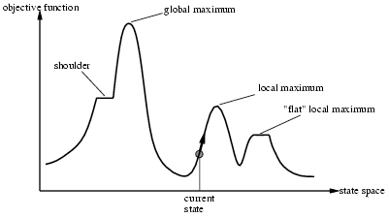
Hill-climbing search
Problem: depending on initial state, can get stuck in local maxima

Slide 18

Example: n-queens
Put n queens on an n × n board with no two queens on the same row, column, or diagonal

Slide 19
Hill-climbing: 4-queens
4 queens on q 4x4 board
optimization criterion: number of attacked pairs of queens
illustrated through red lines

Slide 20
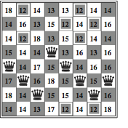
Hill-climbing search: 8-queens
h = number of pairs of queens that are attacking each other
h = 17 for the above state
best moves are marked (h=12)

Slide 21
8-queens: Attacked Pairs
h = number of pairs of queens that are attacking each other
h = 17 for the above state
best moves are marked (h=12)

Slide 22
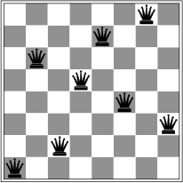
Hill-climbing search: 8-queens problem
A local minimum with h = 1

Slide 23
Hill-climbing search: 8-queens problem
A local minimum with h = 1
one pair of queens attacking each other

Slide 24
Simulated Annealing
similar to hill-climbing, but some down-hill movement
random move instead of the best move
depends on two parameters
∆E, energy difference between moves; T, temperature
temperature is slowly lowered, making bad moves less likely
analogy to annealing
gradual cooling of a liquid until it freezes
will find the global optimum if the temperature is lowered slowly enough
applied to routing and scheduling problems
VLSI layout, scheduling

Slide 25
Local Beam Search
variation of beam search
a path-based method that looks at several paths “around” the current one
keeps k states in memory, instead of only one
information between the states can be shared
moves to the most promising areas
stochastic local beam search selects the k successor states randomly
with a probability determined by the evaluation function

Slide 26
Logistics - Oct. 16, 2012
AI Nugget presentations scheduled for Oct. 11
Section 1:
William Budney: SwiftKey
Grant Frame: Autonomous Agile Aerial Robots
Drew Bentz: Stand Up Comedy Robot
Chris Colwell: Watson, IBM's Brainchild
stephen calabrese: Wolfram Alpha (carried over from Oct. 11)
Brandon Page: Google Now (carried over from Oct. 11)
Section 3:
Therin Irwin: Intelligent Databases
Brian Gomberg: Robot SWARM
Bassem Tossoun: Don't Worry, I've Got Siri
Assignments and Labs
A1: Search Algorithms
deadline Tue, Oct. 23
Lab 4: extensions available until Sun, Oct. 21
Lab 5 available: AI in Real Life
Lab submission deadlines fixed: Tue, end of day (not end of lab)
Quiz 4
available all day Tue, Oct. 16
Project
mid-quarter project fair on Thu, Oct. 25
Zynga Event today at 5:30 in 14-252
free food, presentation about getting a job, giveaways

Slide 27
Genetic Algorithms (GAs)
variation of stochastic beam search
successor states are generated as variations of two parent states, not only one
corresponds to natural selection with sexual reproduction
with a twist: swapping body parts
mutation provides an additional random element
random modification of features (variable values)

Slide 28
GA Terminology
population
set of k randomly generated states
generation
population at a point in time
usually, propagation is synchronized for the whole population
individual
one element from the population
described as a string over a finite alphabet
binary, ACGT, letters, digits
consistent for the whole population
fitness function
evaluation function in search terminology
higher values lead to better chances for reproduction

Slide 29
GA Principles
reproduction
the state description of the two parents is split at the crossover point
determined in advance, often randomly chosen
must be the same for both parents
one part is combined with the other part of the other parent
one or both of the descendants may be added to the population
compatible state descriptions should assure viable descendants
depends on the choice of the representation
may not have a high fitness value
mutation
each individual may be subject to random modifications in its state description
usually with a low probability
schema
useful components of a solution can be preserved across generations

Slide 30
GA Applications
often used for optimization problems
circuit layout, system design, scheduling
termination
“good enough” solution found
no significant improvements over several generations
time limit

Slide 31
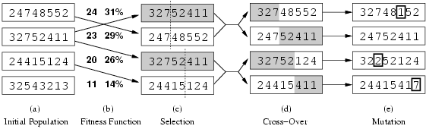
Example: Genetic algorithm
for N-Queens
Fitness function: number of non-attacking pairs of queens (min = 0, max = 8 × 7/2 = 28)
24/(24+23+20+11) = 31%
23/(24+23+20+11) = 29% etc

Slide 32
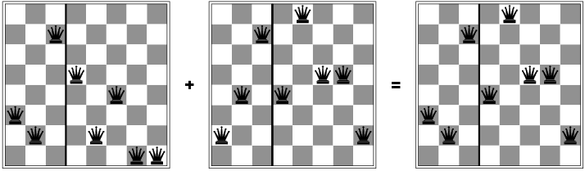
Genetic Algorithm for N-Queens

Slide 33
Constraint Satisfaction
CSP terms and definitions
Examples
Map Coloring
Cryptarithmetic
N-Queens
CSP and Search
Heuristics
Analyzing Constraints
Local Search and CSP

Slide 34
CSP Definitions
satisfies additional structural properties of the problem
may depend on the representation of the problem
the problem is defined through a set of domain variables
variables can have possible values specified by the problem
constraints describe allowable combinations of values for a subset of the variables
state in a CSP
defined by an assignment of values to some or all variables
consistent assignment
does not violate any constraints
also called legal assignment
complete assignment
every variable is mentioned
solution to a CSP
complete assignment that satisfies all constraints
solutions may be ranked according to an objective function

Slide 35
CSP Approach
the goal test is decomposed into a set of constraints on variables
checks for violation of constraints before new nodes are generated
must backtrack if constraints are violated
forward-checking looks ahead to detect unsolvability
based on the current values of constraint variables

Slide 36
CSP Example: Map Coloring
color a map with three colors so that adjacent countries have different colors
variables (regions):
A, B, C, D, E, F, G
A
C
G
values (colors):
{red, green, blue}
B
D
constraints:
“no neighboring regions
have the same color”
F
E
legal combinations for A, B:
{(red, green), (red, blue),
(green, red), (green, blue),
(blue, red), (blue, green)}

Slide 37
Constraint Graph
visual representation of a CSP
variables are nodes
arcs are constraints
A
C
G
the map coloring example
represented as constraint graph
B
D
E
F

Slide 38

Example: Map-Coloring
Variables WA, NT, Q, NSW, V, SA, T
Domains D_{i} = {red,green,blue}
Constraints: adjacent regions must have different colors
e.g., WA ≠ NT, or (WA,NT) in {(red,green),(red,blue),(green,red), (green,blue),(blue,red),(blue,green)}

Slide 39
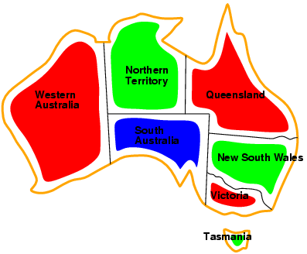
Example: Australia Map-Coloring
Solutions are complete and consistent assignments, e.g., WA = red, NT = green,Q = red,NSW = green,V = red,SA = blue,T = green

Slide 40
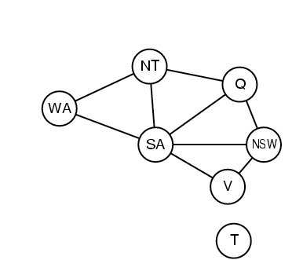
Constraint graph
Binary CSP: each constraint relates two variables
arcs connect exactly two nodes
n-ary CSP uses hypergraphs where arcs can connect more than two nodes
Constraint graph: nodes are variables, arcs are constraints

Slide 41
Varieties of CSPs
Discrete variables
finite domains:
n variables, domain size d → O(dn) complete assignments
e.g., Boolean CSPs, incl.~Boolean satisfiability (NP-complete)
infinite domains:
integers, strings, etc.
e.g., job scheduling, variables are start/end days for each job
need a constraint language, e.g., StartJob1 + 5 ≤ StartJob3
Continuous variables
e.g., start/end times for Hubble Space Telescope observations
linear constraints solvable in polynomial time by linear programming

Slide 42
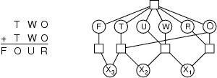
Example: Cryptarithmetic
Variables: F T U W R O X₁ X₂ X₃
Domains: {0,1,2,3,4,5,6,7,8,9}
Constraints: Alldiff (F,T,U,W,R,O)
O + O = R + 10 · X₁
X₁ + W + W = U + 10 · X₂
X₂ + T + T = O + 10 · X₃
X₃ = F, T ≠ 0, F ≠ 0

Slide 43
Benefits of CSP
standardized representation pattern
variables with assigned values
constraints on the values
allows the use of generic heuristics
no domain knowledge is required

Slide 44
CSP as Incremental Search Problem
initial state
all (or at least some) variables unassigned
successor function
assign a value to an unassigned variable
must not conflict with previously assigned variables
goal test
all variables have values assigned
no conflicts possible
not allowed in the successor function
path cost
e.g. a constant for each step
may be problem-specific

Slide 45
CSPs and Search
in principle, any search algorithm can be used to solve a CSP
awful branching factor
n*d for n variables with d values at the top level, (n-1)*d at the next level, etc.
not very efficient, since they neglect some CSP properties
commutativity: the order in which values are assigned to variables is irrelevant, since the outcome is the same

Slide 46
Backtracking Search for CSPs
a variation of depth-first search that is often used for CSPs
values are chosen for one variable at a time
if no legal values are left, the algorithm backs up and changes a previous assignment
very easy to implement
initial state, successor function, goal test are standardized
not very efficient
can be improved by trying to select more suitable unassigned variables first

Slide 47
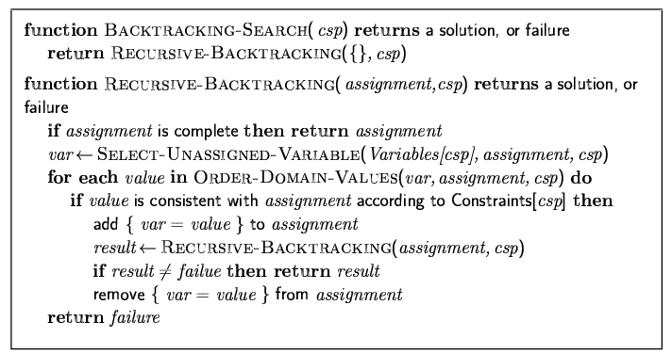
Backtracking search

Slide 48

Backtracking example

Slide 49
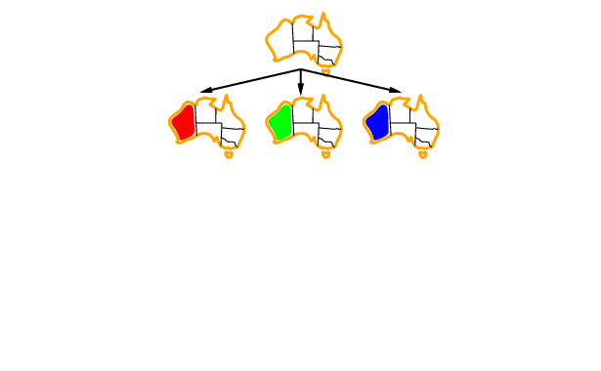
Backtracking example

Slide 50
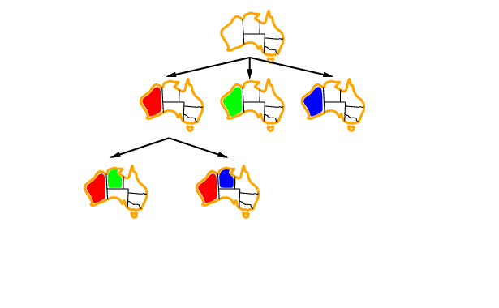
Backtracking example

Slide 51
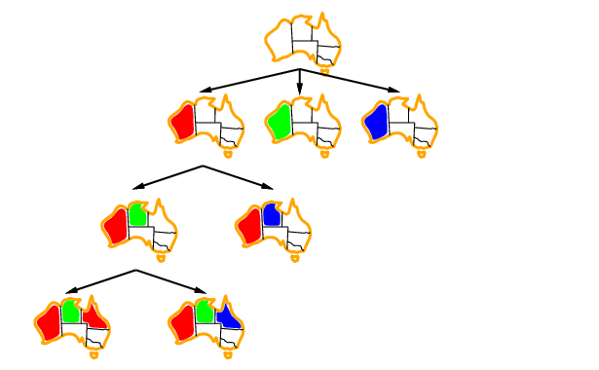
Backtracking example

Slide 52
Improving backtracking efficiency
General-purpose methods can give huge gains in speed:
Which variable should be assigned next?
In what order should its values be tried?
Can we detect inevitable failure early?

Slide 53
Heuristics for CSP
most-constrained variable (minimum remaining values, “fail-first”)
variable with the fewest possible values is selected
tends to minimize the branching factor
most-constraining variable
variable with the largest number of constraints on other unassigned variables
least-constraining value
for a selected variable, choose the value that leaves more freedom for future choices

Slide 54
Analyzing Constraints
forward checking
when a value X is assigned to a variable, inconsistent values are eliminated for all variables connected to X
identifies “dead” branches of the tree before they are visited
constraint propagation
analyses interdependencies between variable assignments via arc consistency
an arc between X and Y is consistent if for every possible value x of X, there is some value y of Y that is consistent with x
more powerful than forward checking, but still reasonably efficient
but does not reveal every possible inconsistency

Slide 55

Most constraining variable
Tie-breaker among most constrained variables
Most constraining variable:
choose the variable with the most constraints on remaining variables

Slide 56
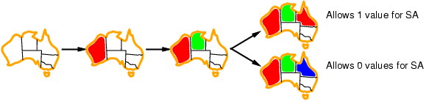
Least constraining value
Given a variable, choose the least constraining value:
the one that rules out the fewest values in the remaining variables
Combining these heuristics makes 1000 queens feasible

Slide 57
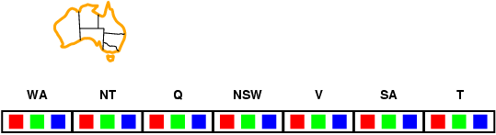
Forward checking
Idea:
Keep track of remaining legal values for unassigned variables
Terminate search when any variable has no legal values

Slide 58
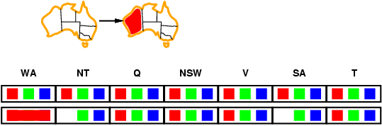
Forward checking
Idea:
Keep track of remaining legal values for unassigned variables
Terminate search when any variable has no legal values

Slide 59
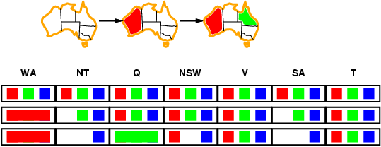
Forward checking
Idea:
Keep track of remaining legal values for unassigned variables
Terminate search when any variable has no legal values

Slide 60
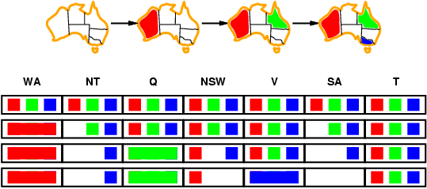
Forward checking
Idea:
Keep track of remaining legal values for unassigned variables
Terminate search when any variable has no legal values

Slide 61
Constraint propagation
Forward checking propagates information from assigned to unassigned variables, but doesn't provide early detection for all failures:
NT and SA cannot both be blue!
Constraint propagation repeatedly enforces constraints locally

Slide 62
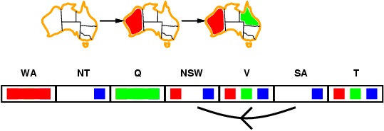
Arc consistency
Simplest form of propagation makes each arc consistent
X →Y is consistent iff
for every value x of X there is some allowed y

Slide 63
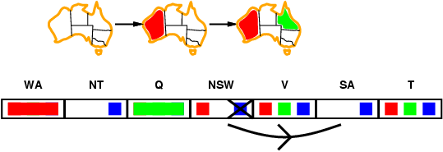
Arc consistency
Simplest form of propagation makes each arc consistent
X →Y is consistent iff
for every value x of X there is some allowed y

Slide 64
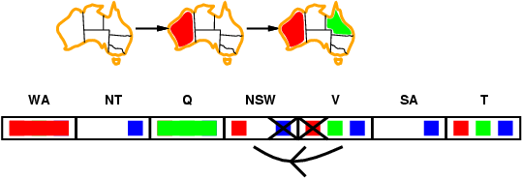
Arc consistency
Simplest form of propagation makes each arc consistent
X →Y is consistent iff
for every value x of X there is some allowed y
If X loses a value, neighbors of X need to be rechecked

Slide 65
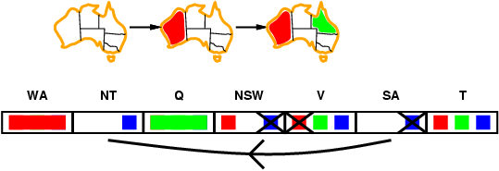
Arc consistency
Simplest form of propagation makes each arc consistent
X →Y is consistent iff
for every value x of X there is some allowed y
If X loses a value, neighbors of X need to be rechecked
Arc consistency detects failure earlier than forward checking
Can be run as a preprocessor or after each assignment

Slide 66
Logistics - Oct. 18, 2012
AI Nugget presentations scheduled for Oct. 11
Section 1:
Grant Frame: Autonomous Agile Aerial Robots (carried over from Oct. 16)
Will Starr: Robotic Lawn Mowers
William Budney: SwiftKey (delayed to Oct. 23)
Haikal Saliba: quantum algorithms in machine learning (delayed to Oct. 23)
Section 3:
John Di Santi: RTS Game AI
Andrew Guenther: Valve's Left 4 Dead AI Director
Assignments and Labs
A1: Search Algorithms
deadline Tue, Oct. 23
Lab 4: extensions available until Sun, Oct. 21
Lab 5 available: AI in Real Life
Quizzes
make-up question can be submitted now
Project
I’m working on the rubrics for project assessment
display space arrangements for mid-quarter project fair on Thu, Oct. 25

Slide 67
Local Search and CSP
local search (iterative improvement) is frequently used for constraint satisfaction problems
values are assigned to all variables
modification operators move the configuration towards a solution
often called heuristic repair methods
repair inconsistencies in the current configuration
simple strategy: min-conflicts
minimizes the number of conflicts with other variables
solves many problems very quickly
million-queens problem in less than 50 steps
can be run as online algorithm
use the current state as new initial state

Slide 68
Local search for CSPs
Hill-climbing, simulated annealing typically work with "complete" states, i.e., all variables assigned
To apply to CSPs:
allow states with unsatisfied constraints
operators reassign variable values
Variable selection: randomly select any conflicted variable
Value selection by min-conflicts heuristic:
choose value that violates the fewest constraints
i.e., hill-climb with h(n) = total number of violated constraints

Slide 69
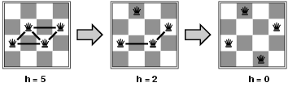
Example: 4-Queens
States: 4 queens in 4 columns (4⁴ = 256 states)
Actions: move queen in column
Goal test: no attacks
Evaluation: h(n) = number of attacks
Given random initial state, can solve n-queens in almost constant time for arbitrary n with high probability (e.g., n = 10,000,000)

Slide 70
Analyzing Problem Structures
some problem properties can be derived from the structure of the respective constraint graph
isolated sub-problems
no connections to other parts of the graph
can be solved independently
e.g. “islands” in map-coloring problems
dividing a problem into independent sub-problems reduces complexity tremendously
ideally from exponential to polynomial or even linear
tree
if the constraint graph is a tree, the CSP can be solved in time linear in the number of variables
sometimes solutions can be found by reducing a general graph to a tree
nodes are removed or collapsed

Slide 71
CSP Example: Map Coloring (cont.)
most-constrained-variable heuristic
A
C
G
B
?
D
F
E
?

Slide 72
8-Queens with Min-Conflicts
one queen in each column
usually several conflicts
calculate the number of conflicts for each possible position of a selected queen
move the queen to the position with the least conflicts

Slide 73
8-Queens Example 1
1
2
2
2
2
2
1
1
3
3
2
2
2
3
1
1

Slide 74
8-Queens Example 1
1
1
3
2
2
3
3
3
1
0
2
2
1
1
2
1

Slide 75
8-Queens Example 1
solution found in 4 steps
min-conflicts heuristic
uses additional heuristics to select the “best” queen to move
try to move out of the corners
similar to least-constraining value heuristics

Slide 76
8-Queens Example 2
2
2
0
1
0
0
2
0
2
3
2
1
2
2
1
2
1
1
2
1
2
2
2

Slide 77
8-Queens Example 2
1
1
1
3
0
2
0
2
2
0
1
0
1
2
1
2
1
3
2
2
1
2
1
2
2
0
2
3
1
3
1
2
1
1
1
1
2

Slide 78
8-Queens Example 2
1
0
0
2
0
0
1
1
1
3
1
1
2
1
0
2
1
1
2
1
1
1
2

Slide 79
8-Queens Example (cont.)
3
2
2
1
2
2
2
2
2
2
2
1
3
4

Slide 80
8-Queens Example (cont.)
2
1
3
2
3
0
2
3
3
3
2
4
1
1

Slide 81
8-Queens Example (cont.)
2
2
3
1
2
4
3
2
2
2
2
2
1
1

Slide 82
8-Queens Example (cont.)
1
2
2
3
1
2
3
3
2
2
2
2
2
1

Slide 83
CSP Properties
discrete variables over finite domains
relatively simple
e.g. map coloring, 8-queens
number of variable assignments can be dn
domain size d, n variables
exponential time complexity (worst-case)
in practice, generic CSP algorithms can solve some problems much larger than regular search algorithms
more complex problems may require the use of a constraint language
it is not possible to enumerate all combinations of values
e.g. job scheduling (“precedes”, “duration”)
related problems are studied in the field of Operations Research
often continuous domains; e.g. linear programming

Slide 84
Logistics 1
Labs
L3 demos continued in lab on Thu
L5: AI in the Real World out, due Tue, Oct. 29
Assignments
A1: Search Algorithms available, deadline tonight
uniform cost, best-first (greedy), A*
Quiz
Quiz 6 coming up on Tue
possibly extended until Wed night if we can’t complete the topic before Tue
Project
Upcoming documentation
System Design & Architecture
Implementation
mid-quarter project displays date: Thu, Oct 31
assignment of teams to locations

Slide 85
Logistics 2
Upcoming AI & HCI Classes
W14: CPE 484 (2 sections)
S14: CPE 481, 580
AI Nugget presentations
Section 1
Brandon Ivy: Google's Quantum Artificial Intelligence Lab
Andrew Acosta: Natural Language Processing
Section 3
Austen Greene: Arimaa
Kyle Hodgkinson: The Singularity
Varun Varahamurthy: SpyParty

Slide 86
Project Displays
Morning Section
Afternoon Section
Team 10
Team 2
Team 17
Team 3
Team 8
Team 4
Team 14
Team 12
Team 16
Team 6
Team 13
Team 18
Team 1
Team 11
Team 9
Team 15
Team 5
Team 7

Slide 87
Search in Continuous Spaces
almost all algorithms discussed earlier are suited only for discrete spaces
some variations of hill climbing and simulated annealing work for continuous environments as well
continuous state and action spaces have infinite branching factors
really bad for most conventional search algorithms
many techniques for search in continuous spaces have been developed in other fields
the development of calculus by Newton and Leibniz provided the main tools

Slide 88
Gradient Descent Search
from the current state, select the direction with the steepest slope
the gradient of the objective function gives the magnitude and direction of the steepest slope
finding the maximum corresponds to solving an equation
in the landscape analogy, the mathematical maximum is often called a minimum since it is the lowest point
in many cases, it is not practical to calculate the global maximum
but it is often easy to compute the local maximum
can be viewed as the inverse of hill climbing

Slide 89
Search with
Non-Deterministic Actions
most of the earlier search algorithms assume an environment that is fully observable and deterministic
this allows off-line search
the agent can first do the calculations for the search until it finds the goal, and then pursue a particular path by executing the respective actions
in non-deterministic environments, the agent needs to deal with contingencies
situations where important information is only available at the time the agent executes its actions
the solution to a problem then is not a sequence of actions, but a contingency plan (strategy)
it can contain nested if-then-else statements

Slide 90
AND-OR Search Trees
trees used to find contingent solutions for non-deterministic problems
OR nodes express choices the agent has in each state
these correspond to the nodes in a deterministic search tree
AND nodes reflect choices by the environment (contingencies)
the agent needs to prepare a plan for all potential choices, which corresponds to a set of AND-connected nodes

Slide 91
Partially Observable Environments
searching with no observation
sensor-less or conformant problems
partial observations and percepts
a single percept may be associated with multiple states
the missing information may distinguish the states

Slide 92
Belief States
the belief-state space consists of all possible states that the agent knows of
in a fully observable environment, each belief state corresponds to exactly one physical state
the belief-state space contains every possible set of physical states
exponential with respect to the physical state size
many nodes in belief-state space may be unreachable
they do not correspond to a valid percept/state combination in the physical environment

Slide 93
Search in Belief-State Space
in belief-state space, search is fully observable
the agent knows its own belief state
there is no sensory input (in belief-state)
the solution is always a sequence of actions for the belief-state
even if the actual environment is non-deterministic
the percept received after each action is predictable, since it is always empty
the agent updates its belief state as information about the physical states becomes available
practical approaches are known under various names
filtering, state estimation
many use probabilistic techniques

Slide 94
Online Search and Unknown Environments
in online search, the agent interleaves search and execution steps
often necessary in dynamic or non-deterministic environments
in unknown environments, the agent has no choice but to perform online search
also known as exploration problem
actions may be non-reversible
this leads to a dead end, where no goal state is reachable
no viable path to the goal
the agent is not necessarily physically “stuck”

Slide 95
Online Local Search
hill-climbing search is an online method
random restart may not work, however
the agent often can’t just be moved to a random point in a real-world environment
random walk
if the state space is finite, the agent will eventually find a goal or completely explore the state space
combining hill-climbing with memory works better
store a current best estimate (heuristic) for each visited node
leads to an algorithm called learning real-time A* (LRTA*)
complete for finite, safely explorable environments

Slide 96
Post-Test
Notes:
evaluate the learning success of the participants
provide feedback to the students about their achievements
ask for feedback on unclear or difficult parts
point out possible gaps and difficulties
encourage suggestions for improvement

Slide 97
Evaluation
Criteria

Slide 98
Important Concepts and Terms
agent
AND-OR search tree
belief state
completeness
constraint satisfaction
continuous space
depth-limited search
genetic algorithm
general search algorithm
goal
goal test function
gradient descent search
heuristics
hill-climbing search
initial state
iterative improvement search
local search
local beam search
non-deterministic actions
non-deterministic environments
online search
operator
optimality
partially observable environments
path
path cost function
problem
search
simulated annealing
space complexity
state
state space
time complexity
uniform-cost search

Slide 99
Chapter Summary
tasks can often be formulated as search problems
initial state, successor function (operators), goal test, path cost
various search methods systematically comb the search space
uninformed search
breadth-first, depth-first, and variations
informed search
best-first, A*, iterative improvement
the choice of good heuristics can improve the search dramatically
task-dependent

